Slide 1





path2integrity.eu
What Values Guide Students' Research Practices?
First Results of a Research Integrity Evaluation Study
EERA 2021
Julia Prieß-Buchheit (presenting), Nicolaus Wilder, Immo Degner, Marie Alavi, Linda Zollitsch
This project receives funding from the European Union’s Horizon 2020 research and innovation programme under grant agreement No 824488.

Slide 2
Research Question for Higher Education
Why should (and how can)
someone who does not see themselves as a “researcher”
learn about Research Integrity ?
The importance of the research habitus/orientation within a complex and diverse world

Slide 3

Higher Education and Society face a challenge
… Many students lack a research habitus:
this jeopardizes the credibility of research - and its function as a rational framework of orientation for society.
This is linked to
fake news and ill-informed populism

Slide 4
Research as a rational framework of orientation for society
“Research is the quest for knowledge obtained through systematic study and thinking, observation and experimentation”
(ECoC 2017, p. 3).
“Good research practices are based on fundamental principles of research integrity. They guide researchers in their work as well as in their engagement with the practical, ethical and intellectual challenges inherent in research”
(ECoC 2017, p. 4).
“Research offers people orientation in a complex and diverse world.”
(Mittelstraß 2019)

Slide 5

Research Habitus
It is founded upon
Reliability
Honesty
Respect
Accountability
(ECoC 2017)

Slide 6
Research Question and Methods
Do students in higher education see themselves as researchers with research integrity?
  Group discussions about responsible conduct of research
  Feedbacksheet assessing direct learning experiences
  in the Path2Integrity learning programme
  4-tier multiple-choice test from
  the Path2Integrity learning programme

Slide 7
Results from the group discussion
Qualitative empirical study
Data collection: 2020
4 groups: master’s students, educational studies, Germany
5-6 students each group

Slide 8
Results from the group discussion
The groups
describe a substantial lack of orientation, which is particularly evident through silence, laughter, or evasive reactions
emphasize that practical participation in research is necessary for understanding research, but that they lack this experience
do not see their perception as a problem neither as students nor for their professional future
reveal opportunist action to complete the study programme with as little resistance as possible

Slide 9
Results from the group discussion
The absence of research experience shows that a research habitus has neither explicit nor implicit relevance for master’s students studying education in higher education.
The groups are convinced on the explicit level that they already have enough knowledge regarding good research practices.
However, they do not reflect this knowledge at the action level in the form of a research habitus.

Slide 10
Results from the Feedback Sheet
Quantitative empirical study
Data Collection: 2020 - 2021
Survey: Far-reaching data collection in the European region and beyond
536 international students of different degrees and disciplines voluntarily attending our non-randomized evaluation

Slide 11
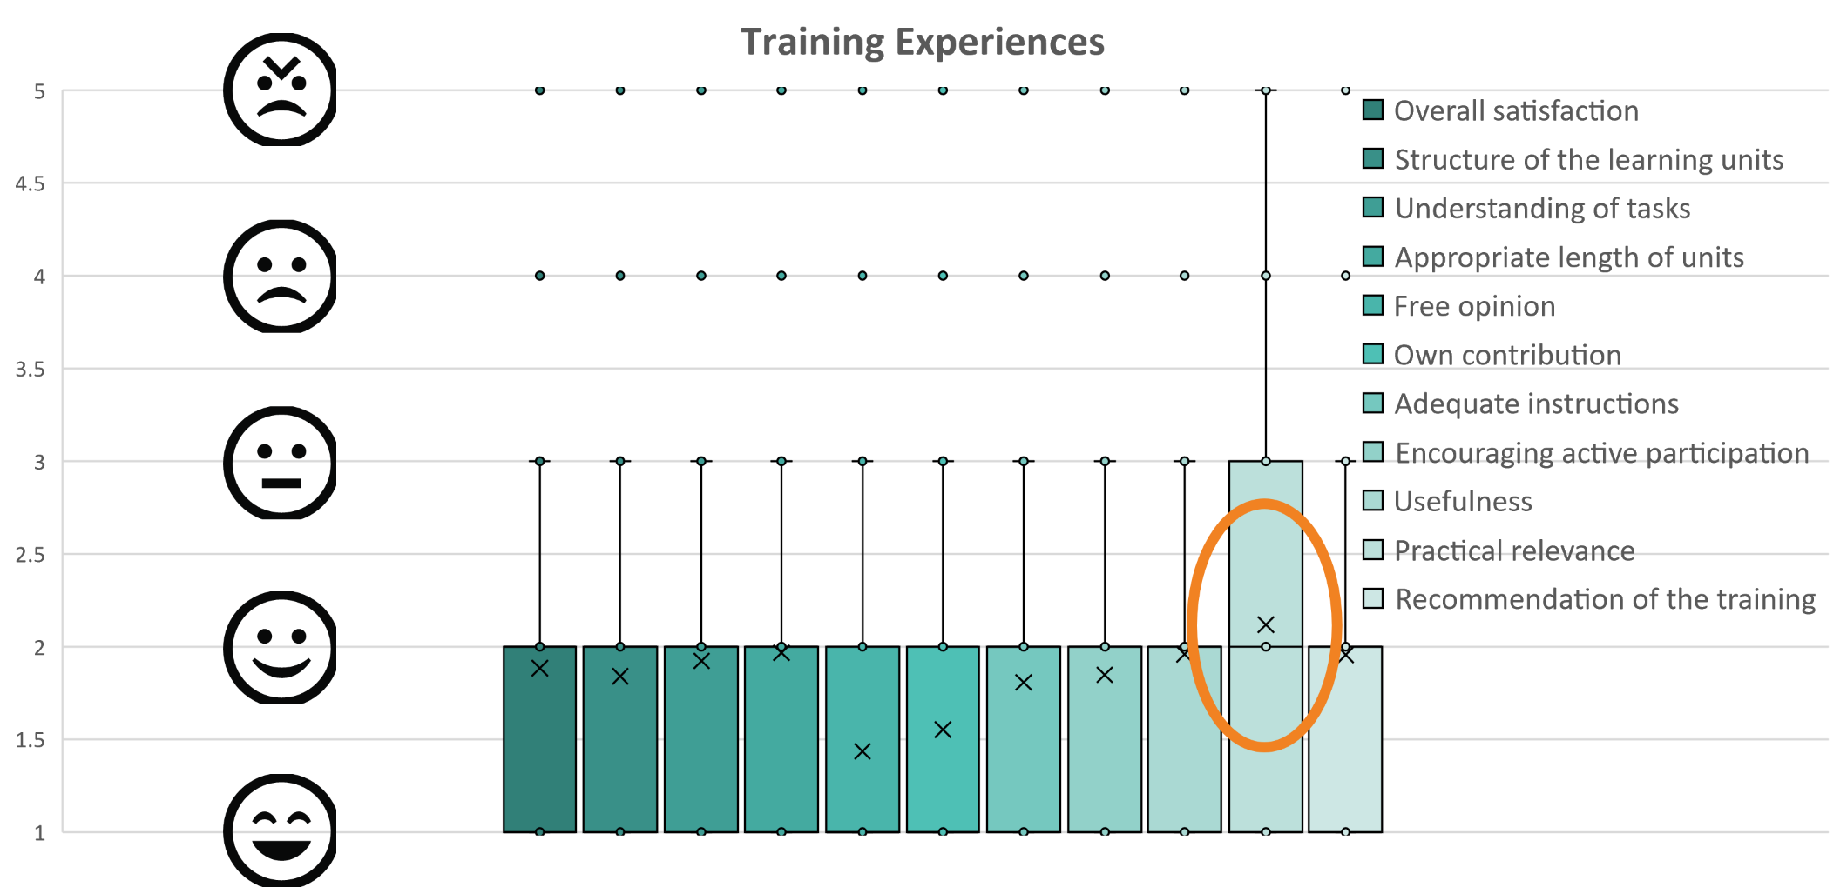
Results from the Feedback Sheet

Slide 12
Results from the 4-tier multiple-choice test
Quantitative empirical study
Data Collection: February till May 2021
Survey: Far-reaching data collection in the European region
614 international students of different degrees and disciplines voluntarily attending our non-randomised evaluation

Slide 13
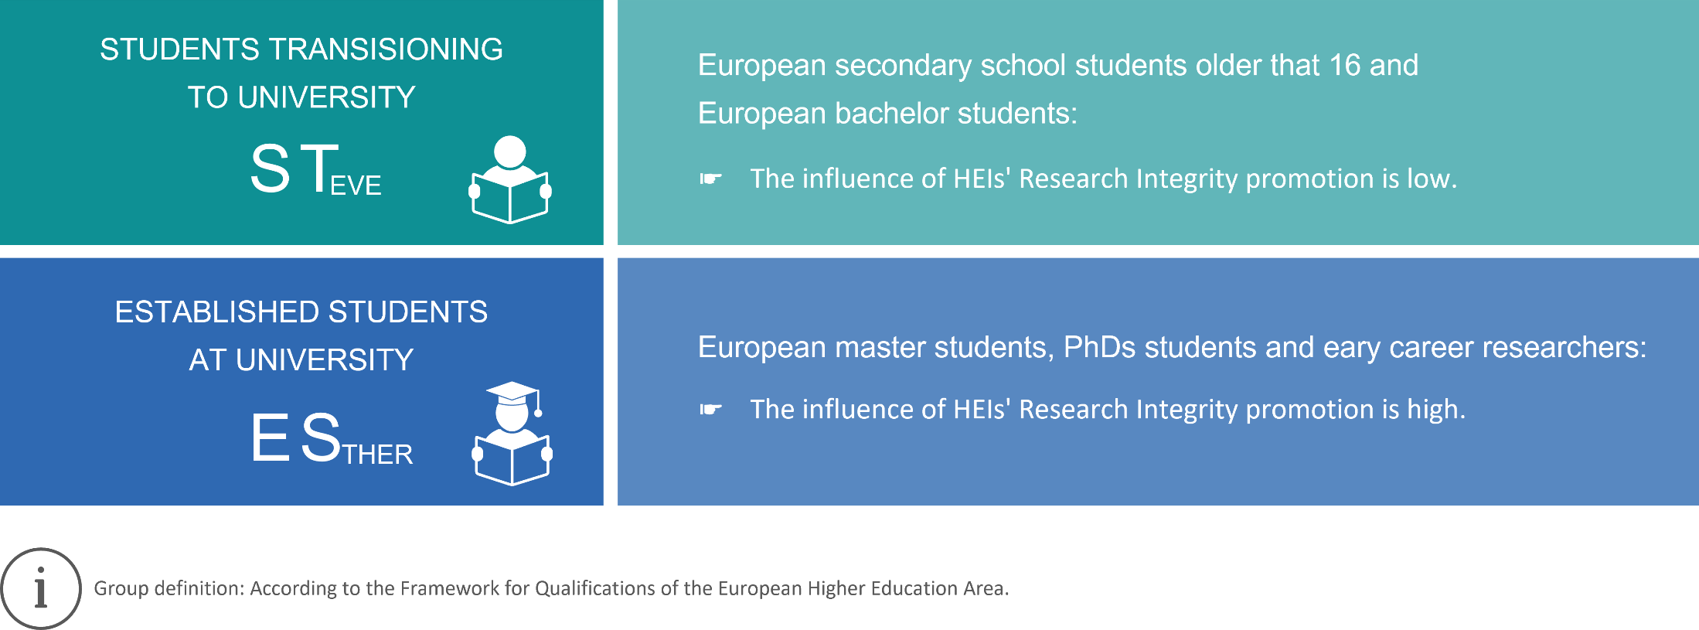
Results from the 4-tier multiple-choice test

Slide 14
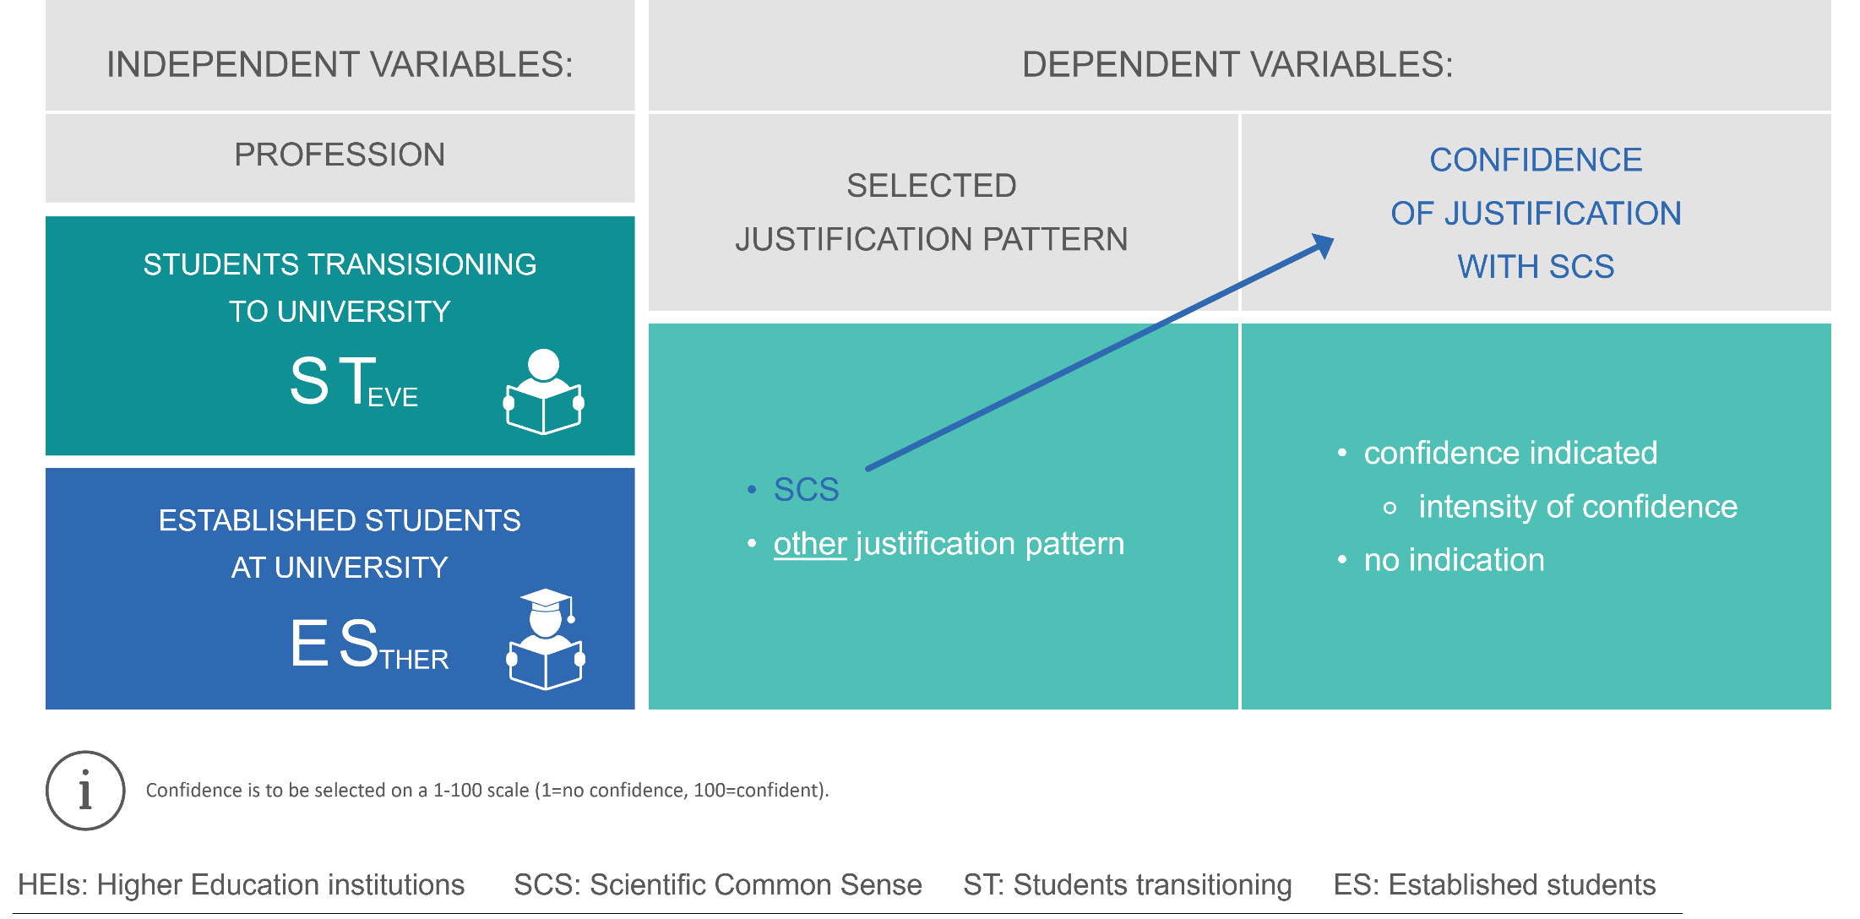
Results from the 4-tier multiple-choice test

Slide 15
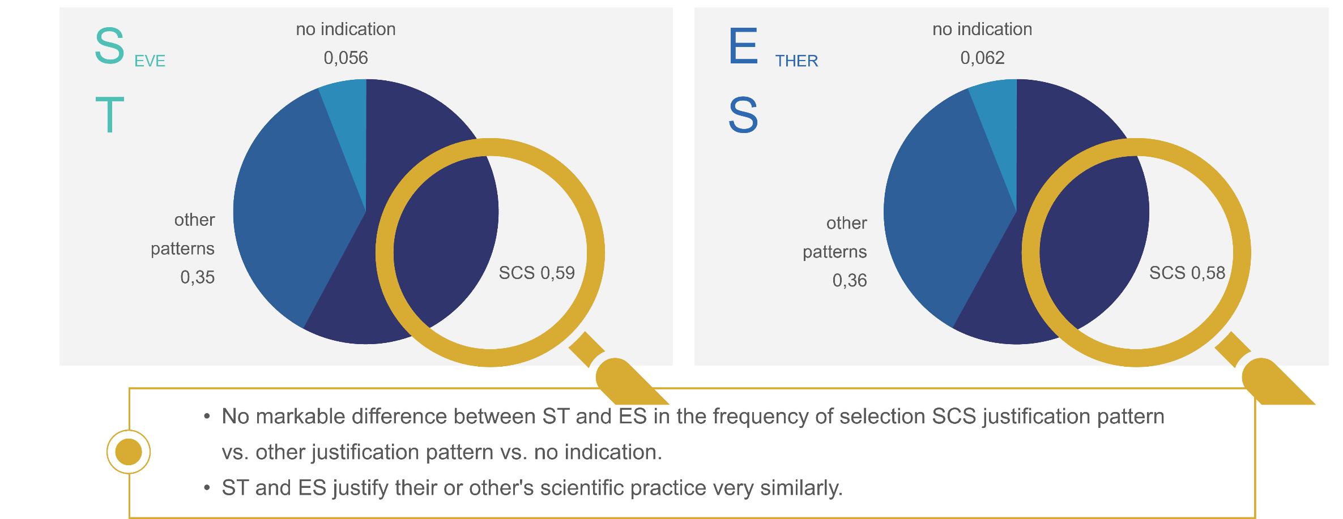
Results from the 4-tier multiple-choice test

Slide 16
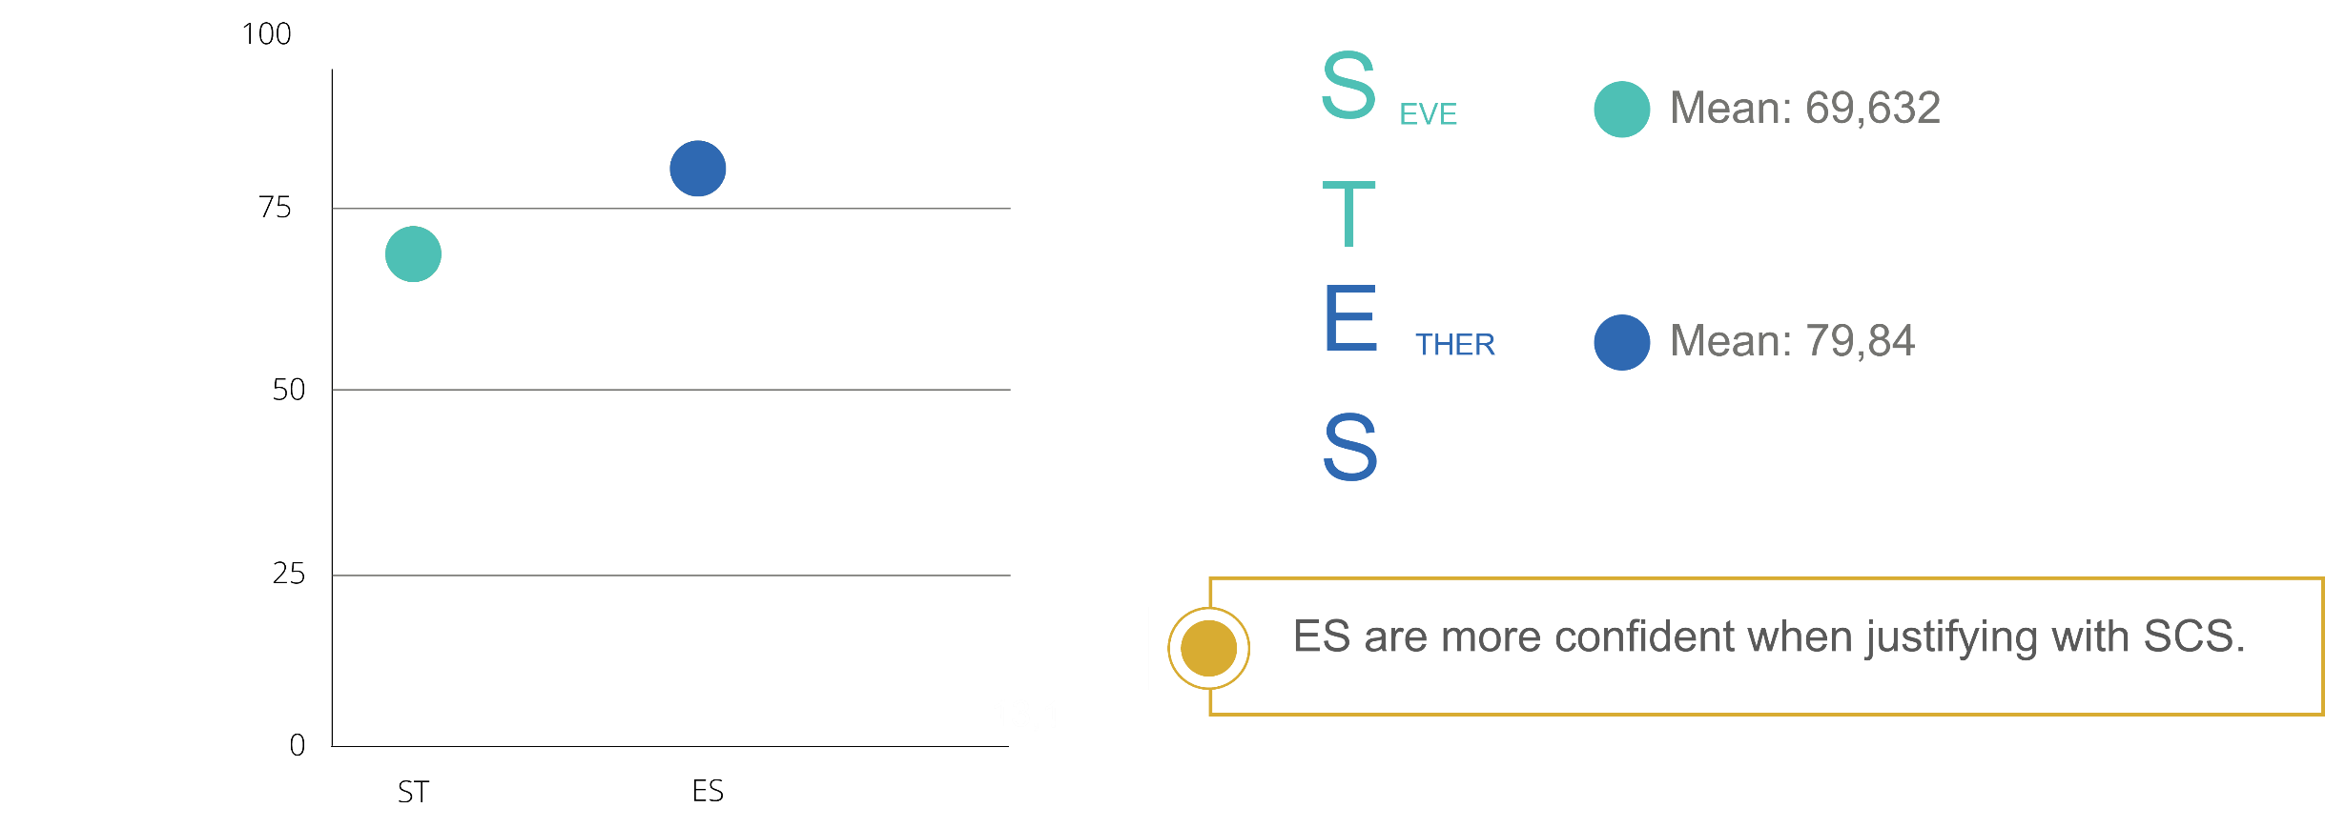
Results from the 4-tier multiple-choice test
Statistically significant difference with α=0,005.

Slide 17
Overall results to the research question
  Do students in higher education see themselves
  as researchers with research integrity?

Slide 18
Overall results to the research question
~ 55% of the European students use scientific common sense to justify their and others scientific practice.
This ratio does not change with their qualification cycle in higher education.
The higher students’ qualification cycle, the higher their confidence in choosing scientific common sense as a reason for scientific practice.

Slide 19
Overall results to the research question
Students across all higher education degrees in Europe rate practical relevance of research integrity training below average.
For Master’s students (studying education in Germany) research habitus has no relevance.
Master’s students think they have already enough knowledge regarding good research practices. However, they do not show expertise at the action level in the form of a research habitus.

Slide 20
What values guide students research practice?
The results are alarming
and need to be proven by a replication study or in further research:
What values guide students research practice?
Many students lack a research habitus, which jeopardises the credibility of research and its function as a rational framework of orientation for society.

Slide 21
Literature
[1] Mittelstraß, J. (2019). Bildung in einer Wissensgesellschaft. heiEDUCATION Journal. Transdisziplinäre Studien zur Lehrerbildung, 21-36 Seiten. https://doi.org/10.17885/HEIUP.HEIED.2019.3.23942 Deppert, W. (2019). Theorie der Wissenschaft: Band 2: Das Werden der Wissenschaft. Springer Fachmedien Wiesbaden. Barnett, R. (2000). Supercomplexity and the Curriculum. Studies in Higher Education, 25(3), 255–265. https://doi.org/10.1080/713696156 [2] Basten, M., Mertens, C., Schöning, A., & Wolf, E. (Hrsg.). (2020). Forschendes Lernen in der Lehrer/innenbildung. Waxmann. https://doi.org/10.31244/9783830991540 [3] Healey, M., & Jenkins, A. (2018). The role of academic developers in embedding high-impact undergraduate research and inquiry in mainstream higher education: Twenty years’ reflection. International Journal for Academic Development, 23(1), 52–64. https://doi.org/10.1080/1360144X.2017.1412974 Healey, M., & Jenkins, A. (2009). Developing undergraduate research and inquiry. https://www.advance-he.ac.uk/knowledge-hub/developing-undergraduate-research-and-inquiry Brew, A. (2013). Understanding the scope of undergraduate research: A framework for curricular and pedagogical decision-making. Higher Education, 66, 603–618. [4] ALLEA – All European Academies (Hrsg.). (2017). The European Code of Conduct for Research Integrity. https://www.allea.org/wp-content/uploads/2017/05/ALLEA-European-Code-of-Conduct-for-Research-Integrity-2017.pdf [5] Zhou, X., Zafarani, R., Shu, K., & Liu, H. (2019). Fake News: Fundamental Theories, Detection Strategies and Challenges. Proceedings of the Twelfth ACM International Conference on Web Search and Data Mining, 836–837. https://doi.org/10.1145/3289600.3291382 [6] Noury, A., & Roland, G. (2020). Identity Politics and Populism in Europe. Annual Review of Political Science, 23(1), 421–439. https://doi.org/10.1146/annurev-polisci-050718-033542 [7] Prieß-Buchheit, J., Aro, A., Demirova, I., Lanzerath, D., Stoev, P., & Wilder, N. (2020). Rotatory role-playing and role-models to enhance the research integrity culture. Research Ideas and Outcomes, 6, e53921. https://doi.org/10.3897/rio.6.e53921 [8] Bohnsack, R. (2017). Praxeologische Wissenssoziologie. Barbara Budrich. Bohnsack, R., Pfaff, N., & Weller, W. (Hrsg.). (2010). Qualitative Analysis and Documentary Method: In International Educational Research. Barbara Budrich. https://doi.org/10.3224/86649236 Bohnsack, R. (2010). Rekonstruktive Sozialforschung: Einführung in qualitative Methoden. Barbara Budrich. [9] Pan, S. J.-A., & Chou, C. (2015). Using a Two-Tier Test to Examine Taiwanese Graduate Students’ Misunderstanding of Responsible Conduct of Research. Ethics & Behavior, 25(6), 500–527. https://doi.org/10.1080/10508422.2014.987921 Peşman, H., & Eryılmaz, A. (2010). Development of a Three-Tier Test to Assess Misconceptions About Simple Electric Circuits. The Journal of Educational Research, 103(3), 208–222. https://doi.org/10.1080/00220670903383002 [10] Bohnsack, R., & Przyborski, A. (2007). Gruppendiskussionsverfahren und Focus Groups. In R. Buber & H. H. Holzmüller (Hrsg.), Qualitative Marktforschung (S. 491–506). Gabler. https://doi.org/10.1007/978-3-8349-9258-1_31

Slide 22
Contact
Prof. Dr. Julia Prieß-Buchheit
Project Coordinator
Coburg University of Applied Sciences and Arts
Coburg, Germany
julia.priess-buchheit@hs-coburg.de

